Slide 1

Predicting User Posting Behavior Using r/Depression Data
High Risk Project
vae377
Notes:
Hello everybody this is my high risk project on predicting user behavior on the r / depression subreddit

Slide 2
Motivation
Mental Health is as important as physical health
Online platforms are important spaces for people suffering to find community
Can AI be used to improve the health outcomes of users of the r/depression?
Notes:
Of course mental health is as important as physical health
Increasingly people suffering from both mental and physical health issues are turning to online communities for help and support
This could be instead of or together with professional help
Can AI help in increasing the value of these spaces online

Slide 3
Background / Goals
r/depression is a “subreddit” on the popular social media platform – Reddit
There are currently 1.1 Million Members
My dataset contained ~30,000 posts from 2020
Example Post
Title: Help
Post: I was happy when i finally stopped with self harm and now i want to start again...
Goal: Based of the content of a post, can an AI model predict accurately whether the author of that post will post again
This could help with intervention if someone is at risk of disengagement
This could be used to better the platform design and user experience
Notes:
r depression is a subreddit or group specific to those suffering from depression
Posts can include
reaching out for advice (medication, am I depressed)
explaining their experience
seeking community
This is pretty dark stuff
Based off the text from a post can an AI model predict whether that user will post again?
Of course worst case scenario if someone was at risk of self harm this could be used for intervention
More indirectly could it be used to improve the user experience based off (well these kinds of posts typically never posted again , maybe they didn’t find what they were looking for

Slide 4
Methods - Preprocessing
Posts that were marked as ‘removed’ were removed from the dataset
Posts where the author had since deleted their account were removed
Posts that were too long to fit entirely into a text embedding model were removed
Remaining posts all were labeled with a new value “last_post”
This was a “1” if the author of that post also posted again after that
This was a “0” if the author of that post never posted again
Notes:
Obvious
Would add noise to the data
Going out of order here but the pre trained model I used only could accept a length of 512 tokens before needing to truncate, so removed those
Go off the utc time posted and author of the post and label the last post as 1

Slide 5


METHODS - PREPROCESSING
Was author’s last post
Was not author’s last post
Notes:
First step in any AI project should be looking at the data
Admitedly I didn’t do this but these word clouds show that the content of the two types of posts are very similar
Top words without stop words

Slide 6
Methods - Preprocessing
Embedding post text
Use pre-trained transformer embedding model
microsoft/MiniLM-L12-H384-uncased
This model is known for being quite powerful despite its relatively small number of trainable parameters
The output of this model is a 384-length vector representing a post
After all posts were embedded, I standardized each one so that the entire dataset had a mean of 0 and standard deviation of 1 (at each index of the vector)
Notes:
Continuing with preprocessing
Pre trained model from hugging face library
33M parameters vs BERT base 109M parameters

Slide 7
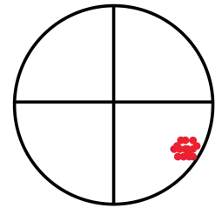
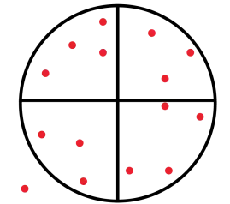
Methods - Preprocessing
Before Standardizing
After Standardizing
Notes:
Output space of a model like the one I used is trained on text from all over the internet and or literature
So, the output for these posts will all be very similar as relative to all other content it’s seen they are very similar
“posts online”
“all about depression”
Shows how separation may become easier after standardization

Slide 8
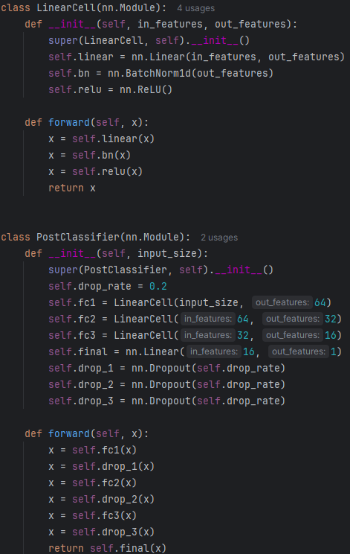
Methods - Training
My Custom Neural Network
384 Length Input
3 Hidden “Linear Cells”
Output layer to a single neuron (1 or 0 according to last_post label)
Notes:
Linear cells all contain
Batch normalization and Relu
Dropout after each cell to reduce overfitting

Slide 9
Methods - Training
Loss Function :Binary Cross Entropy Loss
Optimization : Adam Optimizer with a learning rate of 0.01 and weight decay of 5e-5
Scheduler : ReduceLROnPlateu (drop rate of 0.1 and done 3 times)
Performance was evaluated using accuracy , Precision, Recall and F1 Score
10-fold cross validation used to make sure the generalization was meaningfully tested
Notes:
Loss – predicts one value from 0 to 1 how likely
Scheduler – tested on the test set after every epoch. If it hasn’t improved it’s loss, drop the learning rate 3 times
10 fold cross validation – split into 10 chunks and trained on each set of 9 to 1 and get the average test set performance

Slide 10
Methods -Training
Pos_weight in Binary Cross entropy loss
Used to balance an imbalance in class distribution
83% of data points are labelled “0”
Pos weight of 5.6 means that the “total” loss is now equal for 0’s and 1’s
Forces model to try and learn 1’s instead of predicting only 0’s
Notes:
Positive weight value used to force the model to predict 1’s
Calculated as the inverse proportion of positive classes to total dataset

Slide 11
RESULTS
Alpha | Accuracy | F1 Score
0.5 | 0.79 | 0.16
0.6 | 0.71 | 0.24
0.7 | 0.64 | 0.28
0.8 | 0.60 | 0.29
0.9 | 0.56 | 0.30
1.0 | 0.54 | 0.30
Notes:
Alpha is the decimal value of that 5.6 “base” positive weight value
So at 0 it can get 83% accuracy and 0 F1 by just predicting all 0’s

Slide 12
Methods – Tried but not used
Fine tune the pre-trained model directly
Slow!
Use PCA to reduce dimensionality of the 384-length vector
Notes:
You can use the pre trained models and hook them up to a loss function and tune that entire large model directly
This is a very slow process – 90 minutes per epoch
Would not be surprised if this could actually perform marginally better , but to slow to find out in this project
PCA to reduce to (in my case 64 values) so then I could use the title as well. , but this also did not perform as well

Slide 13
Conclusion
Not successful in predicting the label to any actionable degree
Can’t fit a camel through the eye of a needle
Future work
Larger dataset (or different domain)
Larger pre-trained model
Conclude that text alone is not a valid predictor in this type of project
Notes:
Short answer was no success
The phrase is important in remembering AI isn’t magic and if there is no way to predict Y from X, it won’t be able to
Larger dataset to find more separation as well as ensure that last posts are in fact last posts
Larger pre trained model with more parameters
We’ve all heard you never know what someone is going through by how they act, so if after these steps are taken no predictive power is found we can say quantifiably that this is true – an important finding in and of itself

Slide 14
Acknowledgements
https://www.wordclouds.com/
https://www.curioustem.org/stem-articles/accuracy-vs-precision
https://huggingface.co/microsoft/MiniLM-L12-H384-uncased
https://www.analyticsvidhya.com/blog/2024/11/all-minilm-l6-v2/
https://ieeexplore.ieee.org/document/8639408
https://www.analyticsvidhya.com/blog/2020/10/improve-class-imbalance-class-weights/

